Slide 1
Shapes Pew Peww
Randall Harper
Ryan Gattis
John Boling

Slide 2
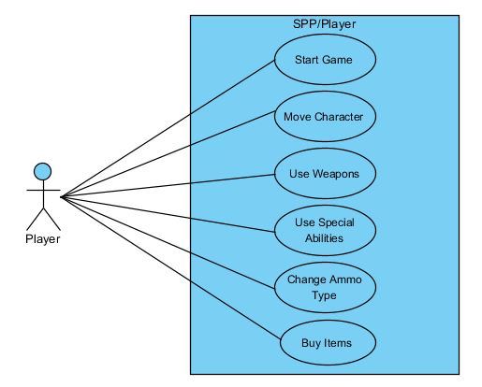
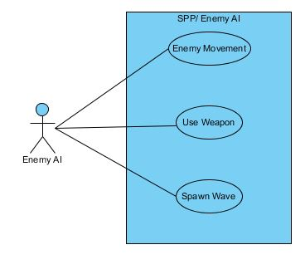
Use Case Diagram

Slide 3
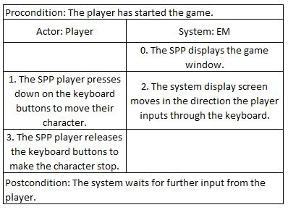
Expanded Use Case – Move Character

Slide 4
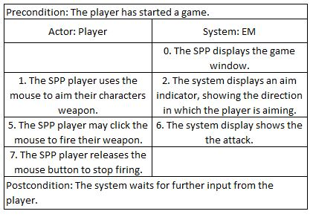
Expanded Use Case – Use Weapon

Slide 5
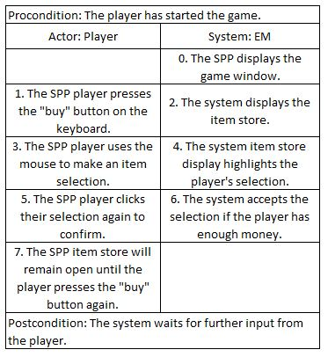
Expanded Use Case – Buy Items

Slide 6
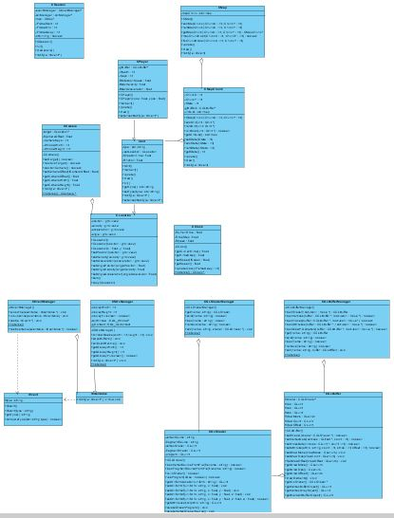
Design Class Diagram
CSession
CMap
CMapChunk
IUnit
CPlayer
CCamera
CLocation
CClock

Slide 7
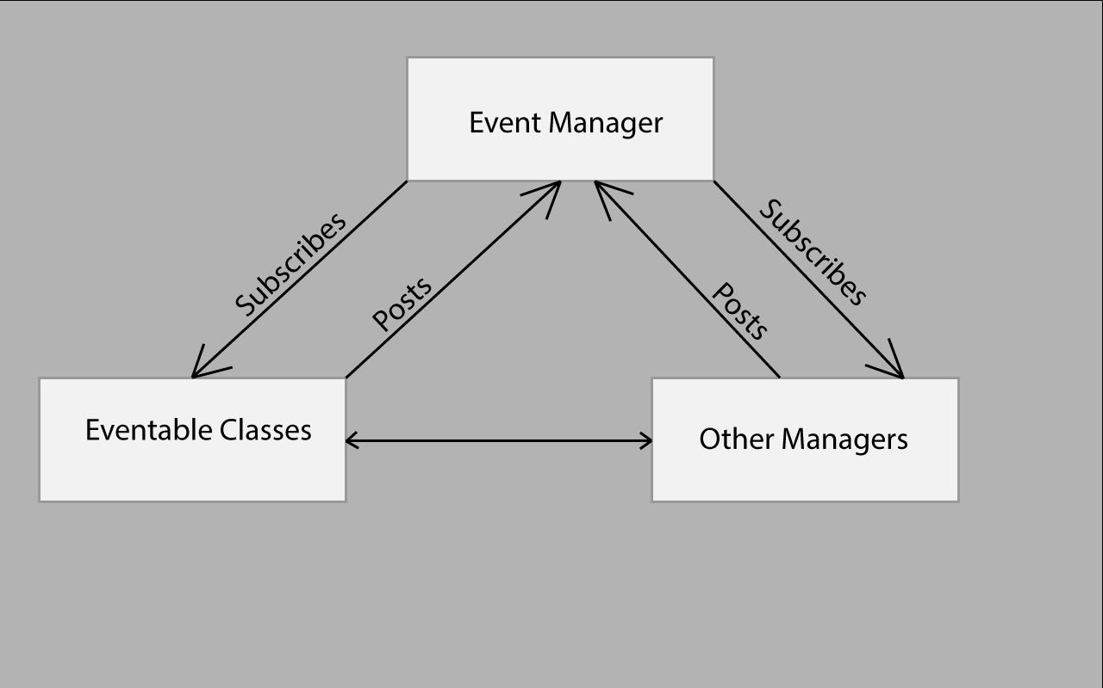
Architectural Model

Slide 8
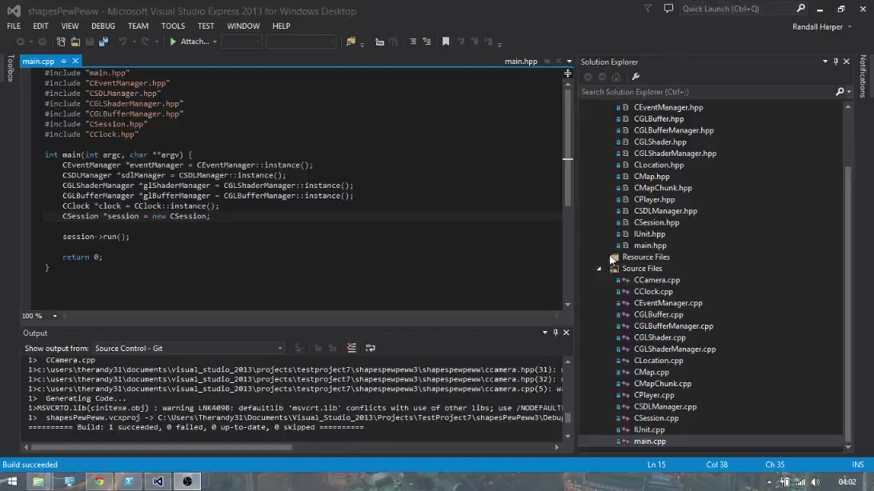
Code Demonstration

Slide 9
Updated Team Member Assignments
 | Planned | Accomplished
John Boling | Game Interface Boss Strategy | Player/Enemy Graphics
Ryan Gattis | Weapons Implementation | Movement/Rotation Implementation
Randall Harper | Enemy AI | Map/Grid Implementation

Slide 10
Appendix
We built this project for PC users, sorry if you have a Mac.
Go to https://github.com/Jboling/TestProject7
Download the .zip of all the project files
For more a more detailed installation guide, find the Installation ReadMe PowerPoint on https://github.com/Jboling/TestProject7

Slide 11
Code Files Modified/Developed
Ryan Gattis
main, CCamera, CClock, CEventManager, CGLBuffer, CGLBufferManager, CGLShader, CGLShaderManager, CLocation, CSDLManager, CSession
Randall Harper
CMapChunk, CMap
John Boling
CPlayer, IUnit

